Slide 1

Securing Computer Folders with Rijndael Security Extension and Your Bluetooth Enabled Mobile Phone
Presented by Group no. PR13

Slide 2
Team Details
Group no: PR13
Branch: Computer Science and Engineering
Project Title: Securing Computer Folders with Rijndael Security Extension and Your Bluetooth Enabled Mobile Phone
Team Leader: Krishna Kumar Singh

Slide 3
Team Members
Aanchal Gupta
Krishna Kumar Singh
Firoj Khan
Aman Singh
Guide Name: Ms. Kanchan

Slide 4
Platform/Language
PyQT5
External Stylesheets
Python
SQL

Slide 5
Hardware & Software Requirement
Bluetooth
PC/Laptop
Mobile

Slide 6
Procedure
1) Have bluetooth enabled in your laptop or PC.
2) Write an interface to discover bluetooth devices.
3) With an Admin password authenticate the MAC address. MAC address of your mobile gets stored in Registry of the System.
4) Your application will start as a background process as soon as you start your PC.
5) In the configuration mode select a folder as your Working folder.
The program must have a timer to read contents of all files of all types including video of that folder.
6) The program implements a Handshake protocol with your device in every 5 seconds.
7) As soon as you go away from PC, it encrypts all the files of the folder and log off your account.
8) Soon as you Log in to the account, it searches for your Bluetooth Mac address. It prompts you with the password. If password matches, decrypts all the files.
9) If somebody else logs into your system, bluetooth device if any do not get matched, hence the application never asks for Password.

Slide 7
UNIQUE IDEA
Better than folder lock
Easy to detect folder lock
Brute Force Attack (Password attack)
Stolen password

Slide 8
2. AES
Developed in four years (1997-2001)
Key size 128 bits = 3.4 x 10³⁸ Possible Combination
Time to crack 128 bits = 1.02 x 10¹⁸ ( 1 billion billion years)
https://www.eetimes.com/document.asp?doc_id=1279619

Slide 9
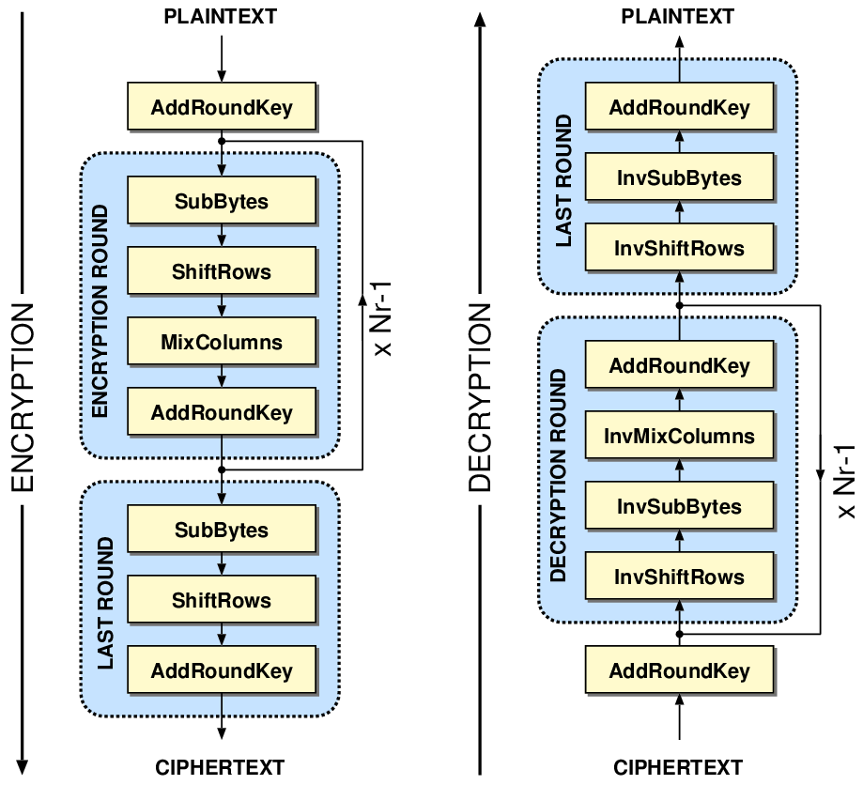
AES Structure

Slide 10
Folder Secure Application
Login and Signup Feature
Bluetooth Feature
Handshake protocol
Folder Encryption Feature
Folder Decryption Feature

Slide 11
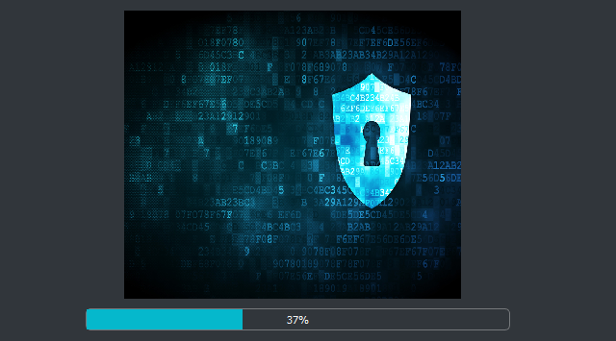
Completed Modules
Login and Signup Feature
Bluetooth Feature
Handshake Protocol
Folder Encryption Feature
Folder Decryption Feature
Integration

Slide 12
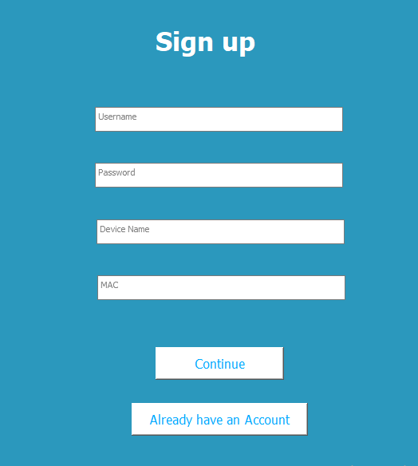
Completed Modules
Login and Signup Feature
Bluetooth Feature
Handshake Protocol
Folder Encryption Feature
Folder Decryption Feature
Integration

Slide 13
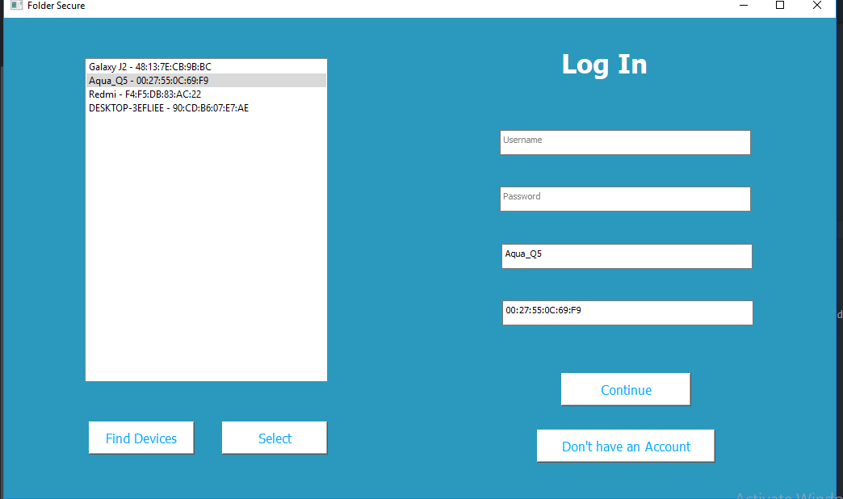
Completed Modules
Login and Signup Feature
Bluetooth Feature
Handshake Protocol
Folder Encryption Feature
Folder Decryption Feature
Integration

Slide 14
Completed Modules
Login and Signup Feature
Bluetooth Feature
Handshake Protocol
Folder Encryption Feature
Folder Decryption Feature
Integration

Slide 15
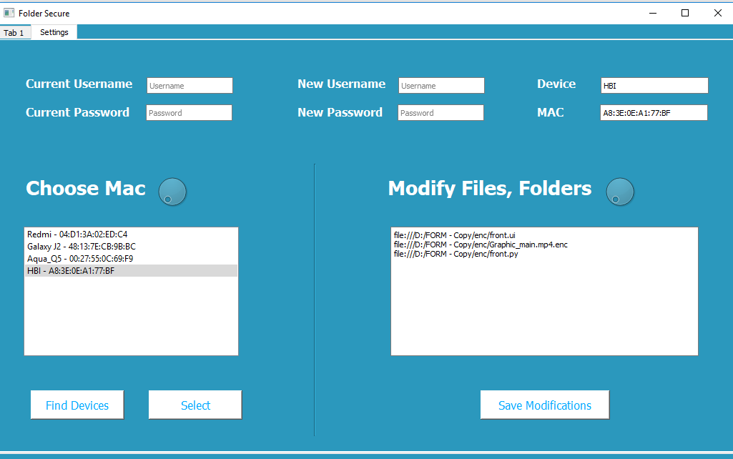
Completed Modules

Slide 16
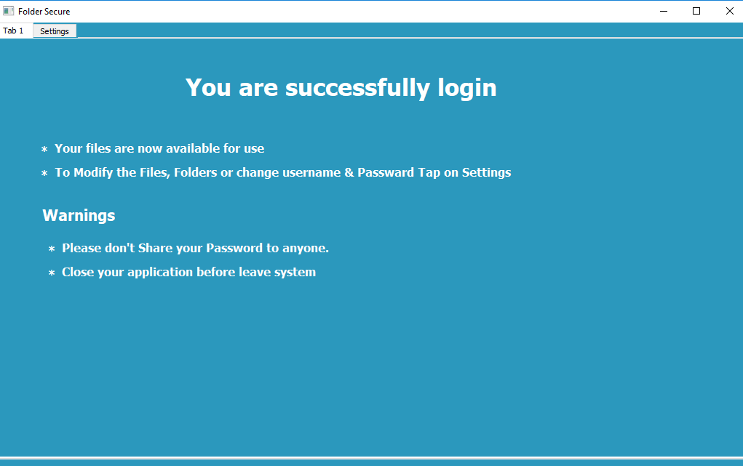
Completed Modules
Login and Signup Feature
Bluetooth Feature
Handshake Protocol
Folder Encryption Feature
Folder Decryption Feature
Integration

Slide 17
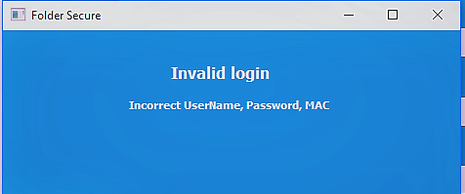
Completed Modules
Login and Signup Feature
Bluetooth Feature
Handshake Protocol
Folder Encryption Feature
Folder Decryption Feature
Integration

Slide 18
LIVE DEMO

